Slide 1

Facade Design Pattern

Slide 2
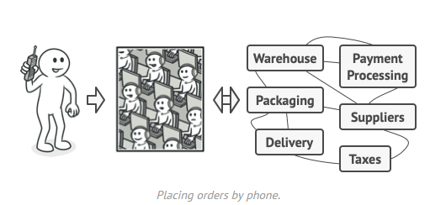
Real World Analogy

Slide 3
Working
When you call a shop to place a phone order, an operator is your facade to all services and departments of the shop.
The operator provides you with a simple voice interface to the ordering system, payment gateways, and various delivery services.

Slide 4
Facade Design Pattern
Facade pattern hides the complexities of the system and provides an interface to the client using which the client can access the system.
This type of design pattern comes under structural pattern as this pattern adds an interface to existing system to hide its complexities.
This pattern involves a single class which provides simplified methods required by client and delegates calls to methods of existing system classes.

Slide 5
Applicability
Use the Facade pattern when you need to have a limited but straightforward interface to a complex subsystem.
Use the Facade when you want to structure a subsystem into layers.

Slide 6

Pros and Cons
You can isolate your code from the complexity of a subsystem.
A facade can become a god object coupled to all classes of an app.

Slide 7
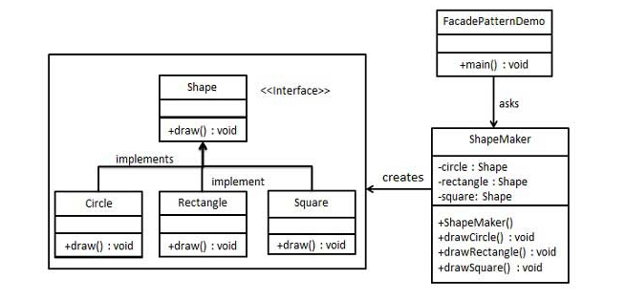
Example

Slide 8
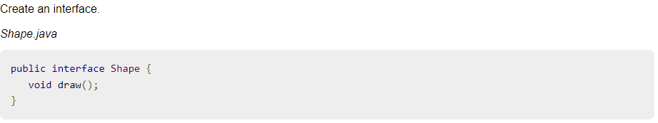
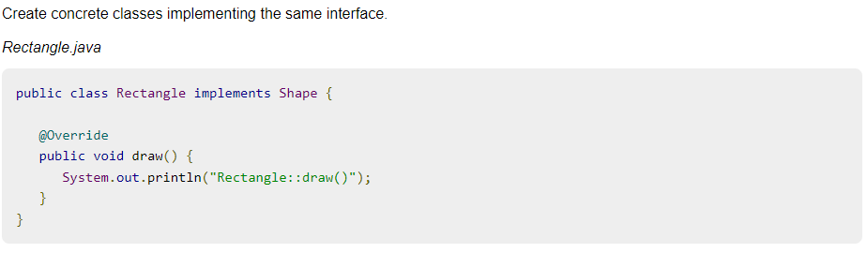

Slide 9
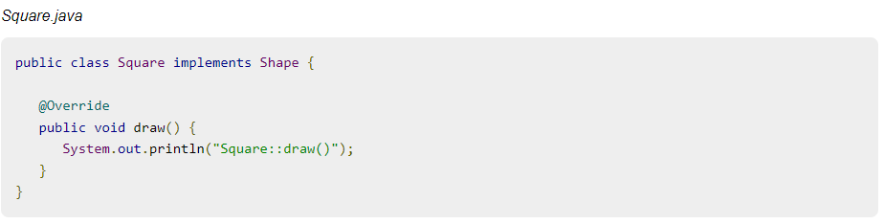
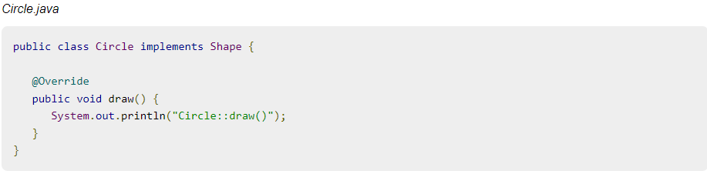

Slide 10
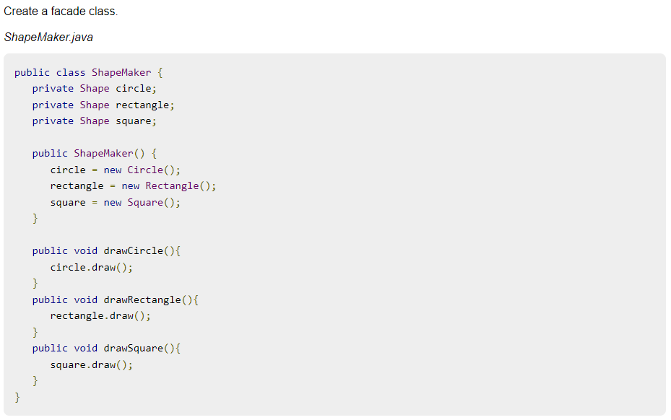

Slide 12
